Slide 1
Hulu Clone Project
Cyril Rollins

Slide 2
Project Overview
This project is a web-based video streaming application inspired by Hulu.
It allows users to browse, watch and manage video content while demonstrating full-stack development

Slide 3
Purpose
To design and build a scalable streaming platform that showcases backend development, database relationships.

Slide 4
Core Features
User registration and login
Browse videos by category
Watch videos
Add and remove videos from watchlist

Slide 5
Technology Stack
Backend: Node.js
Frontend:HTML, CSS, JavaScript
Database:PostgreSQL

Slide 6
Database Schema
Main entities:
User
Video
Category
Watch History
Watchlist

Slide 7
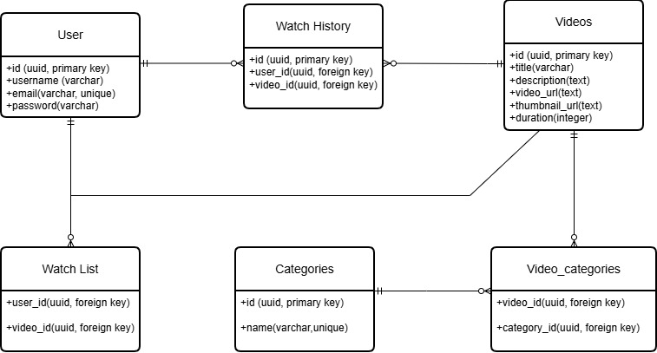
Entity Diagram

Slide 8
Relationships
One user has many watch history records
One user has many watchlist items
Videos can be stores in many categories (many-to-many)

Slide 9
Conclusion
This project demonstrates the ability to design a web application by combining a structed database and functional user interface

